Slide 1
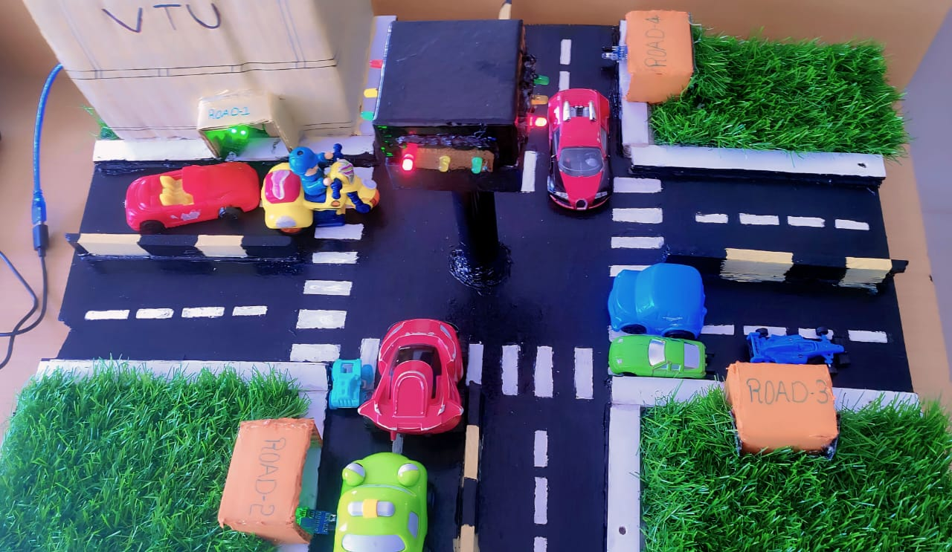
Density based traffic control system
VISVESVARAYA TECHNOLOGICAL UNIVERSITY
PROJECT ON:
Using Arduino uno and IR sensors
PRESENTATION BY : RAJESH S
4VZ22MC073
GUIDED BY : Dr VIKAS S
Assistant professor
Dept. of CSE
VTU, PG Studies ,Mysore

Slide 2
TABLE OF CONTENT
INTRODUCTION
PROJECT OBJECTIVE
COMPONENTS USED
SYSTEM ARCHITECTURE
WORKING PRINCIPLE
ADVANTAGES
DISADVANTAGES
CONCLUSION

Slide 3
INTRODUCTION
In modern life we have to face many problems one of which is traffic congestion becoming more serious day after day. It is said that the high volume of vehicles is the main reasons for increasing traffic jam.
Due to the massive growth in urbanization and traffic congestion, automatic based traffic light controller is needed to reduce the traffic delay and travel time especially in developing countries.
Under present scenario, traffic control is achieved by the use of a system of hand signs by traffic police personnel, traffic signals and markings.
The model works on the principle of changing delay of Traffic signals based on the vehicle standing around an assigned section of the road.

Slide 4
PROJECT OBJECTIVE
Dynamic Traffic Management: The primary objective of our project is to develop a traffic control system that dynamically adjusts signal timings based on real-time traffic density.
Efficient Resource Utilization: Unlike fixed-time traffic signals, our density-based system aims to utilize resources more efficiently.
Enhanced Safety: Another key objective is to improve safety at intersections by minimizing the risk of accidents caused by congestion or gridlock.
Problem Statement: Statement [1]: It works on the time delay even if there is no vehicle on other sides.
Statement [2]: During high traffic the green light is open for a less time, which a very less number of vehicles can pass at once.

Slide 5
COMPONENTS USED
Sl. No. Name of the components Software Required
1 Arduino UNO 1 Arduino IDE
2 IR Sensor
3 LED
4 Battery connector
5 9v DC battery/ Power supply
6 Plywood
7 Jumper wires (Packets)
8 Connecting wires

Slide 6
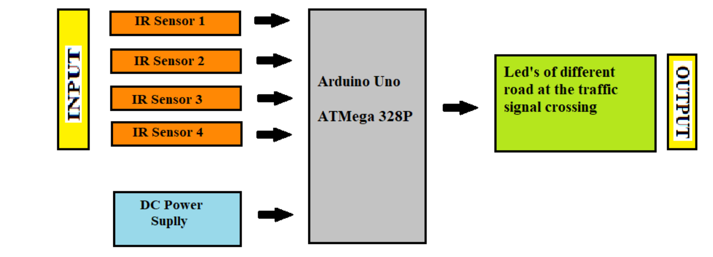
SYSTEM ARCHITECTURE CIRCUIT

Slide 7
DESCRIPTION OF MAIN COMPONENTS
Arduino uno [Reference- http://arduino.cc/en/Guide/Libraries ] The Arduino UNO is ATmega328 datasheet based microcontroller that has 6 analog inputs, 8 digital outputs and 6 PWM outputs. It has a reset button and 16 MHz ceramic resonator with an usb connection facility along with a power jack.
IR Sensor: An infrared Sensor is an electronic device that emits radiations in order to sense some aspects of the surrounding. An IR sensor can measure the heat of an object as well as detect the motion. Usually in the infrared spectrum, all the object radiate some form of thermal radiations.
Led: A light-emitting diode (LED) is a Semiconductor light source that emits light when current flows through it. Electrons in the semiconductor recombine with electron holes, releasing energy in the form of photons. This effect is called electroluminescence.

Slide 8
WORKING PRINCIPLE
Normally when there is less traffic or just say no traffic, the traffic signals will work with the time delay and round robin technique. As there is no traffic the IR sensor will send no data to the micro controller.
When there is a high density of traffic, it become difficult to manage the vehicle. So to overcome this problem we use some modern techniques. Here we implement “Density Based Traffic Control System”.
In the system mentioned above if the traffic at the signal increases continuously , the signal will turn to green in priority wise. The road having the large number of vehicle will be given the green signal first and also duration of the green signal will larger than the standard delay.
Once that road is cleared ,the Arduino will receive no data from the sensor on that road. After clearing this road, the green signal will move to road having less number of vehicle than this road.
Like priority wise , the green signal will move to every road whenever the density of the vehicle is increased on some road of the traffic signal crossing.

Slide 9
ADVANTAGES
Avoid wastage of time due to the traffic.
Fully automatic.
It provides the easy access in the traffic light.
Low cost to design the circuit, maintenance of the circuit is good and easy convenience to handle.

Slide 10
DISADVANTAGES
IR sensors sometimes may absorb normal light also. As a result, traffic system works in improper way.
IR sensors work only for fewer distances.
We have to arrange IR sensors in accurate manner otherwise they may not detect the traffic density.
If sensing is done via image processing, the output would be more accurate but it becomes more complex

Slide 11
CONCLUSION
In conclusion, our density-based traffic control system represents a promising solution to the complex challenges of urban traffic management. Through innovation, collaboration, and a commitment to improving mobility and safety, we believe that our project contributes to the creation of smarter, more efficient, and sustainable cities for the future.

Slide 12


